Slide 1
Seeds of Change
Empowering Orphans through Horticulture, Coding & Storytelling
DD/MM/YYYY
Feature Name/Product
Your Company Name

Slide 2

Introduction
DD/MM/YYYY
Feature Name/Product
Your Company Name

Slide 3
01
Project Overview

Slide 4
Initiative Background
This project is a civic engagement initiative conducted by students from FAST University, under the guidance of Shakeel Ahmed, in partnership with the Edhi Orphan House. The aim was to provide orphans with essential life skills and experiences through various educational activities.
DD/MM/YYYY
Feature Name/Product
Your Company Name

Slide 5
Objectives and Goals
The primary goals of the project include fostering teamwork and emotional development in children aged 7–14. By focusing on horticulture, coding, and storytelling, the initiative aims to fill gaps observed in areas like STEM exposure, nutrition, and self-expression.
DD/MM/YYYY
Feature Name/Product
Your Company Name

Slide 6

Target Audience
The project specifically targeted orphans aged 7–14 years at the Edhi Orphan House. This age group was selected to ensure that the children could grasp the concepts of horticulture, coding, and storytelling, thus providing them with essential skills for their personal and social development.
DD/MM/YYYY
Feature Name/Product
Your Company Name

Slide 7
02
Implementation and Impact

Slide 8
Session Structure
The program comprised 24 structured sessions, each designed to engage the children in hands-on activities. Each session integrated practical lessons on gardening, coding basics, and storytelling, thereby promoting teamwork, hygiene awareness, and creative expression.
DD/MM/YYYY
Feature Name/Product
Your Company Name

Slide 9
Challenges Faced
The initiative encountered several logistical and behavioral challenges, including resource availability, varying levels of engagement among children, and the need for adaptability in teaching approaches to meet individual needs.
DD/MM/YYYY
Feature Name/Product
Your Company Name

Slide 10

Results and Feedback
Feedback from the participants and staff indicated that the program successfully addressed gaps in STEM education, nutrition awareness, and self-expression. The children showed measurable improvement in these areas, and the project received positive evaluations from stakeholders.
DD/MM/YYYY
Feature Name/Product
Your Company Name

Slide 11
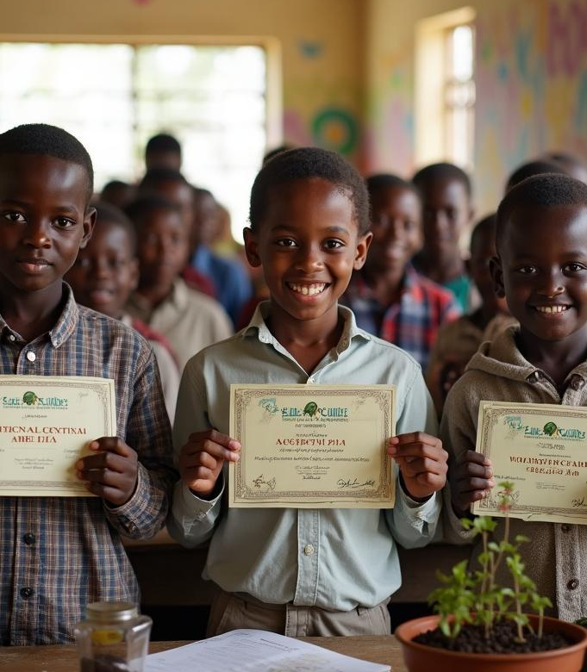
Conclusions
The Seeds of Change initiative demonstrated significant potential for empowering orphans through targeted educational activities. The positive impacts observed indicate the feasibility of similar projects in the future, promoting sustainable development goals.
DD/MM/YYYY
Feature Name/Product
Your Company Name

Slide 12
Thank you!
Do you have any questions?
+91 620 421 838
DD/MM/YYYY
www.yourwebsite.com
Your Company Name

